Slide 1
A Honeytoken based Session Tracking and Threat Evaluation System for Web Applications
ALMA MATER STUDIORUM UNIVERSITÀ DI BOLOGNA
DIPARTIMENTO DI INFORMATICA - SCIENZA E INGEGNERIA
Corso di Laurea in Ingegneria e Scienze Informatiche
Elaborato in Systems Integration
Laureando:
Colotti Manuel Enrique
Relatore:
Prof. Vittorio Ghini
Correlatore:
Dott. Ciro Barbone
Tutor Aziendale:
Dott. Eugenio Cavina
Anno Accademico 2020/2021

Slide 2
Goals
Implementation of a WordPress plugin capable of tracking users’ sessions.
Development of a system capable of assessing the threat level related to each request.
Creation of panels for displaying data on users in graphical form.
Development and execution of tests to verify the proper functioning of the system.

Slide 3
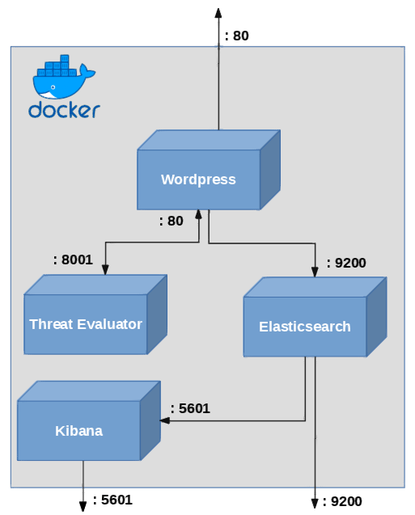
System Architecture
Wordpress CMS
MySQL DBMS
Threat Evaluation System
Elasticsearch e Kibana
Fig. 1.0

Slide 4
Plugin WordPress Session Tracking
Collected Data:
Visitor ID
User IP Address
User’s Email and User_ID as stored in WordPress DB
User Agent
Date and Time of the Request
Session Duration
Accessed Pages
Website URI that is being accessed (HTTP host)
Request’s GET and POST Parameters
HTTP Referer
Save Session Cookies
Threat Indicators: threat_score, threat_status e breach_flag

Slide 5
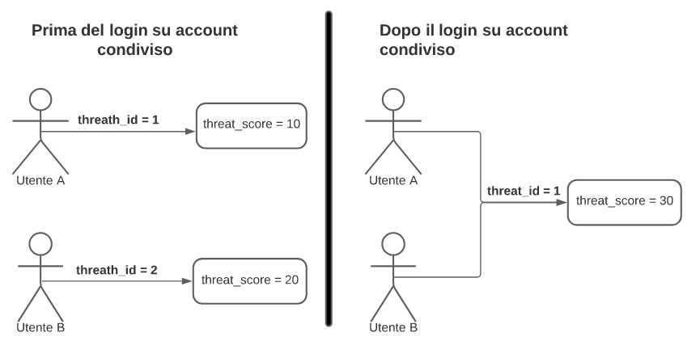
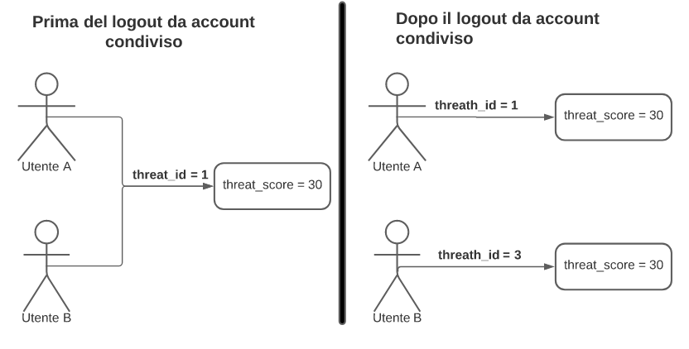
Plugin WordPress Tracking Criteria
Before logging in a shared account
After logging in a shared account
Sessions with a given Visitor ID are uniquely tracked
When a User logs in or logs out of an account, the same session is kept and updated.
Threat Indicators consistency must be guaranteed even after multiple log ins or log outs of an account (figure1.3 and 1.4).
Threat Level Management for accounts shared by multiple users (figure 1.1, 1.2, 1.3 e 1.4).
Fig. 1.1
Fig. 1.2
Before logging out of a shared account
After logging out of a shared account
Fig. 1.3
Fig. 1.4

Slide 6
MySQL DBMS Tables design
Additional Database Tables that enrich WordPress Plugin Session Management:
Sessions: represents a single navigation session
Threat: contains fields that assess the threat level of a session
User (wp_users): table that represents users in a WordPress environment
IP_Addresses: contains fields necessary to bind a session to an IP address
Cookies: represents cookies associated to sessions
Session_Ip: bridge table between Sessions and IPs
Session_User: bridge table between Sessions and Users
Session_Cookies: bridge table between Sessions and Cookies

Slide 7
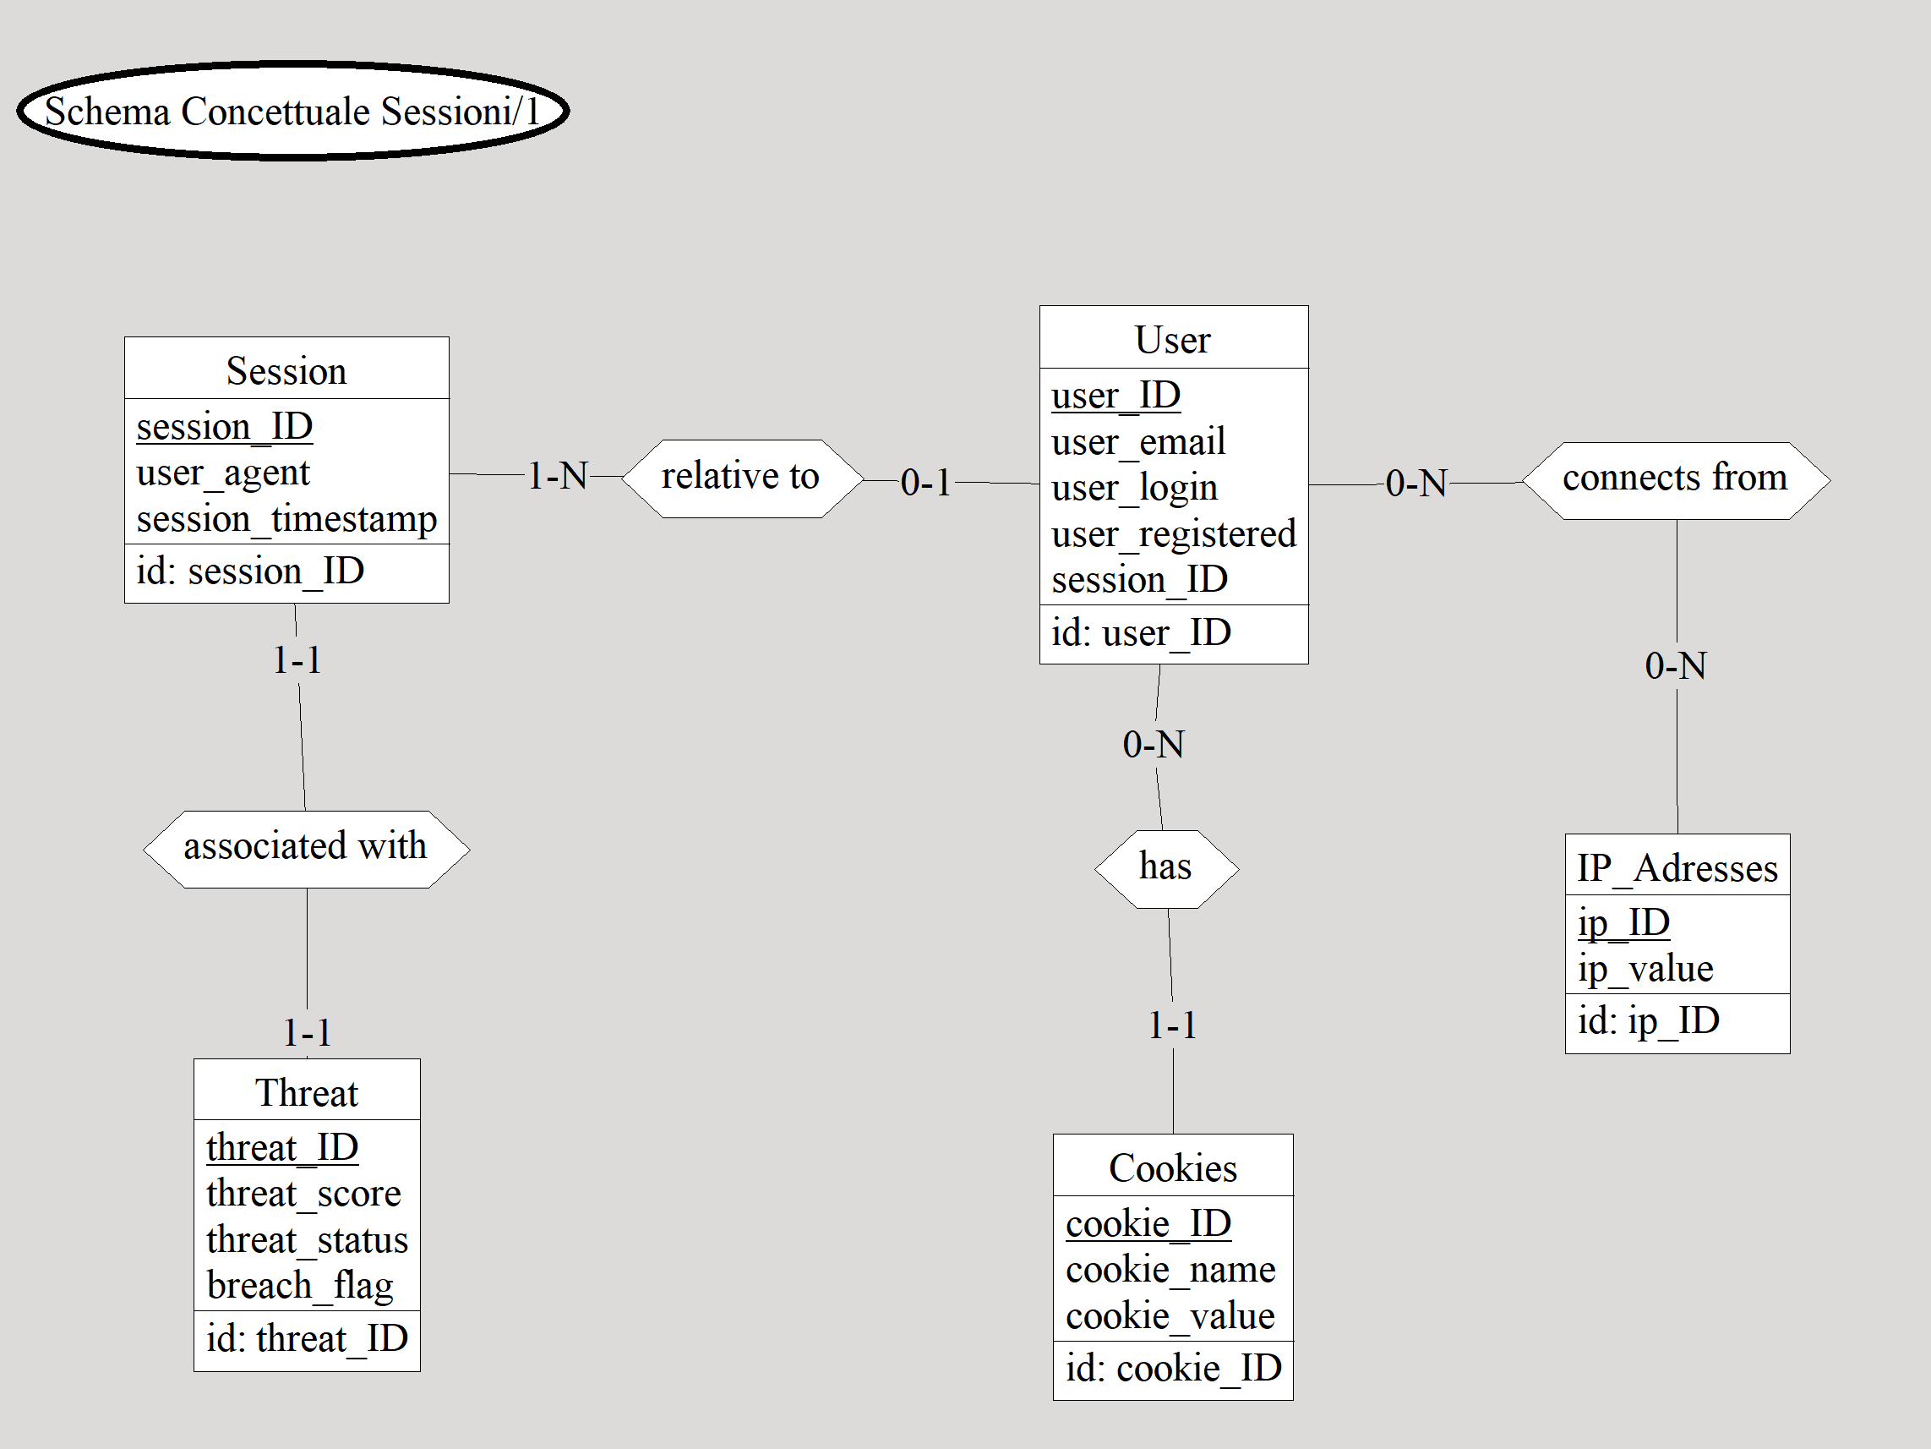
Tables ER Design

Slide 8
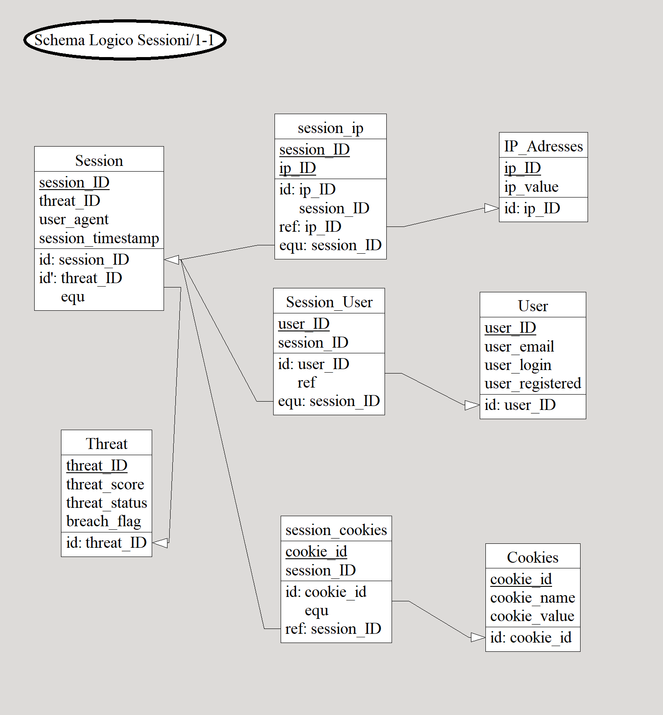
Tables Logical Design

Slide 9
Threat Evaluator
Subsystem that examines an HTTP request received from the WordPress Webserver and determines its dangerousness.
Honeytoken: fictitious data with no information value specifically entered by a system administrator to detect attackers.
Employed Honeytokens for Threat Evaluation:
GET and POST parameters: blacklist of keys and values that should not appear in any HTTP request.
Dummy pages: non-indexed pages that should not be accessed by anyone.
Session cookies: cookies that must be present in the user's browser.
Dummy accounts: accounts whose credentials should not be known to anyone.

Slide 10
Threat Evaluator
Once a request has been evaluated, the Threat Evaluator returns the following parameters:
Threat Score: numerical value related to the dangerousness of a request.
Breach Flag: Boolean value set to true when a user logs in to a dummy account.
Threat Status: represents the threat score value in natural language by dividing it into the following ranges:
0-499 points: safe user
500-1999 points: warning user
>1999 points: dangerous user
breach flag = true: evil user

Slide 11
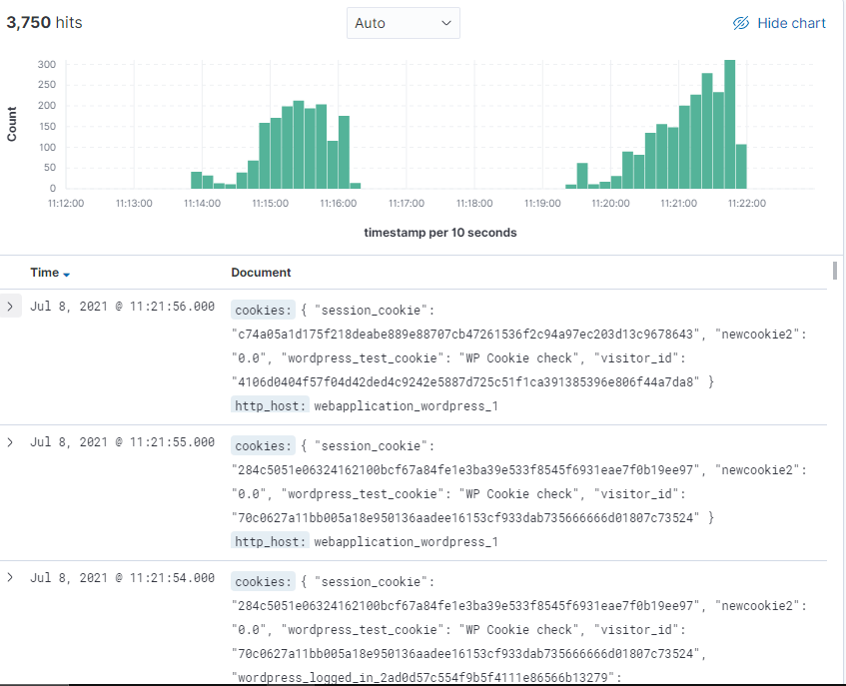
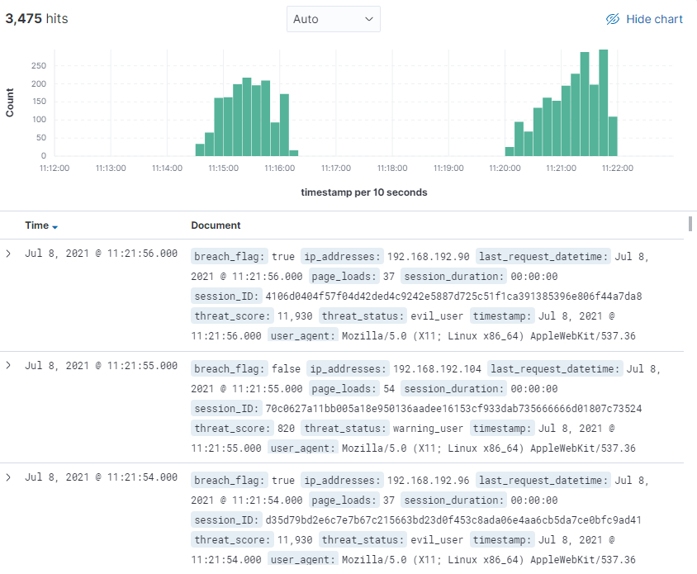
Elasticsearch e Kibana
Elasticsearch: Search engine that allows data to be saved in JSON format within “indexes”.
Kibana: Tool that using data saved on Elasticsearch allows the creation of custom dashboards for graphically visualizing collected information.
Fig 1.5, Requests Index
Fig 1.6, Sessions Index

Slide 12
System’s Testing
Test Components:
Selenium Remote Web Driver: executor that will be responsible for receiving commands from the Java client and executing them on the Wordpress Web Application in the form of HTTP requests.
Java Client: imparts predefined commands to each of the deployed Remote Web Drivers.
Test Scenario:
100 different Remote Web Drivers will be deployed divided into two groups: «good» and «bad»
The 50 «good» instances will send standard requests to the Website
The remaining 50 «bad» instances, on the other hand, will additionally execute a series of potentially dangerous requests that will alert the Threat Evaluation System.

Slide 13
Selenium Remote Web Drivers Deployment
Framework that enables to remotely control one or more instances of a Web Browser
Each Remote Web Driver will be deployed in a different container
Remote Web Drivers execute actions imparted by the Java Controller, depending on their nature (“good” or “bad”).

Slide 14
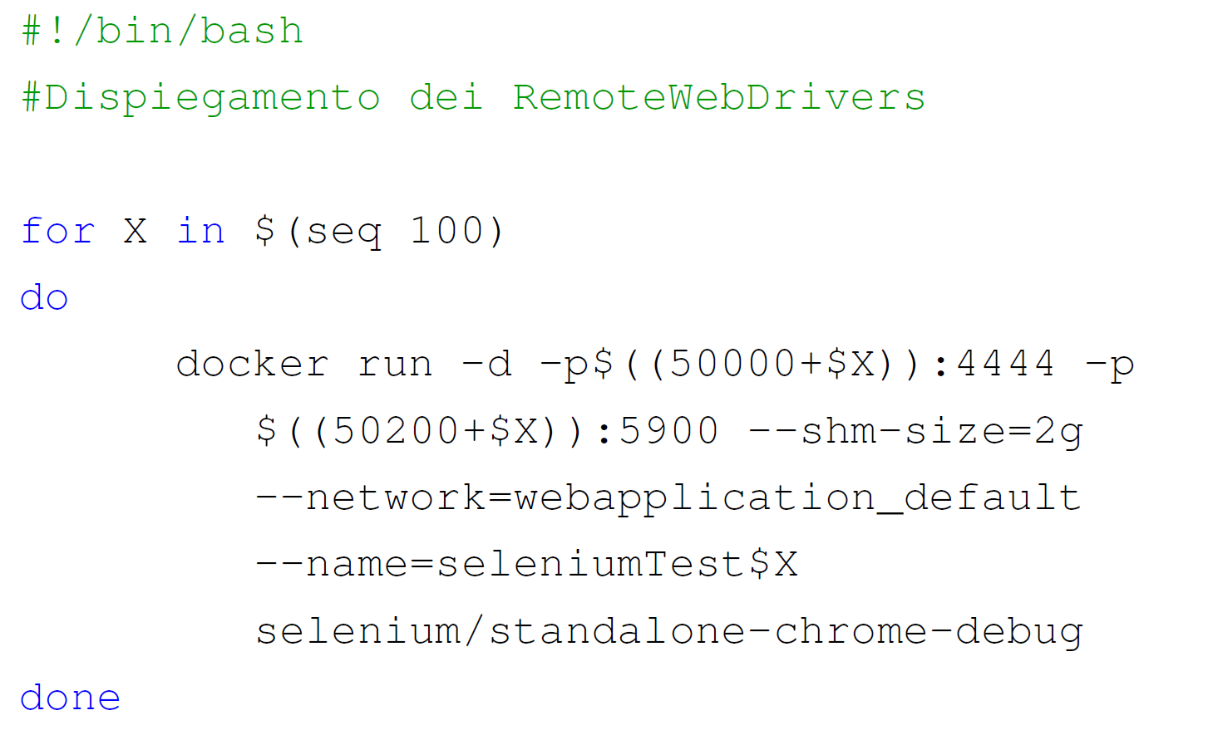
Web Drivers Deployment Script

Slide 15
Java Test Controller
Defines the browsing actions to be performed
Connects to each Remote Web Driver
Assigns to each executor one of the two predefined behavioural profiles and all the actions associated to it.

Slide 16
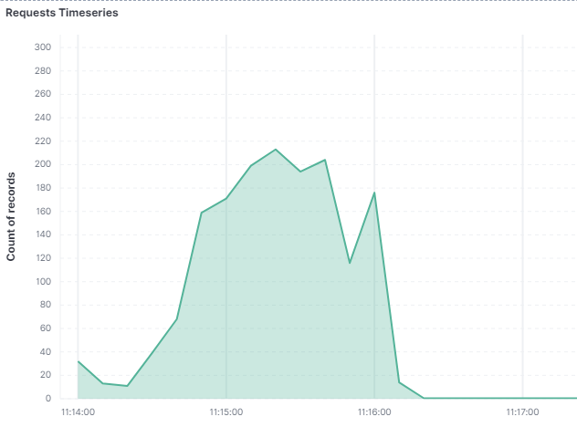
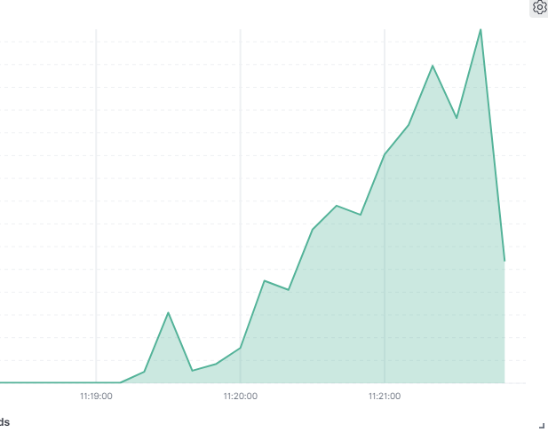
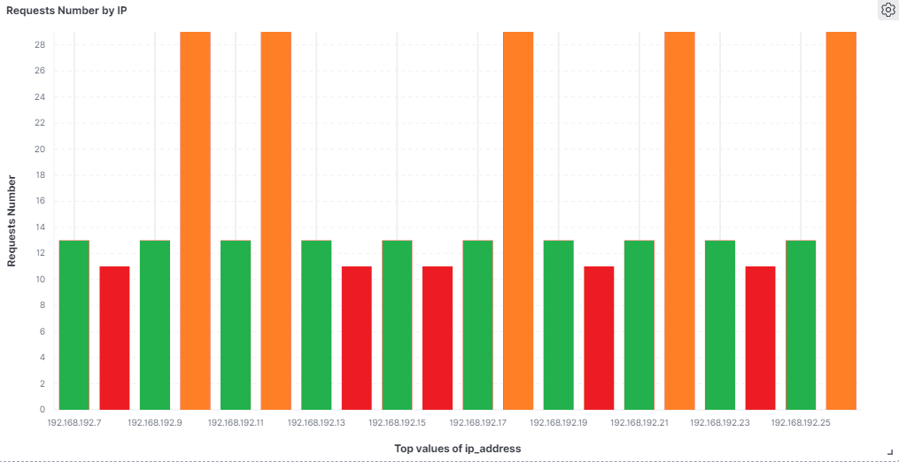
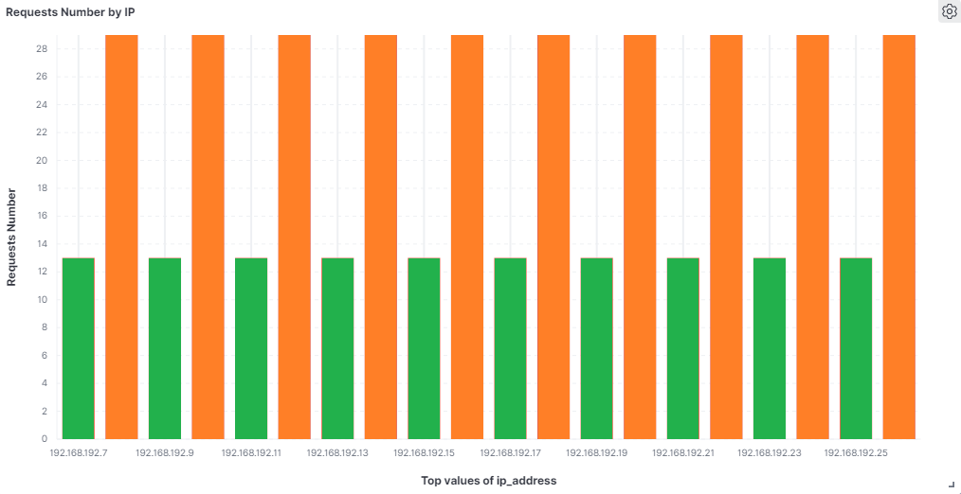
Test Results Analysis
Fig. 1.7
Fig. 1.8
Defense mechanism: active
Total Requests: 1650
Defense mechanism: inactive
Total Requests: 2100
Timeseries of received Requests
Standard Users
Potential Threat Actors
Blocked Threat Actors
Number of received requests by IP Address
Fig 1.9, Defense mechanism: active
Fig 1.10, Defense mechanism: inactive

Slide 17
Future System Developments
Cloud deployment of Threat Evaluation, Elasticsearch and Kibana (Multitenancy) services.
Development of new techniques to differentiate dangerous requests from others (Machine Learning).
Implementation of additional techniques for tracking users within the web application (e.g., SuperCookie).

Slide 18
Thank you for your attention!

